Slide 1
Programming Activity
Write a program that reads input from the user, if the input is an integer, calculate and print the inverse (i.e. 1/value). If the input contains only alphabets print the word in reverse. For example, if the user provides the input “Boy” you should print “yoB”

Slide 2
inputStr = input("Enter the input: ")
if inputStr.isdigit():
print('The inverse is', 1/int(inputStr))
elif inputStr.isalpha():
reverse = "“
for ch in inputStr:
reverse = ch + reverse
print(inputStr, "reversed is", reverse)

Slide 3
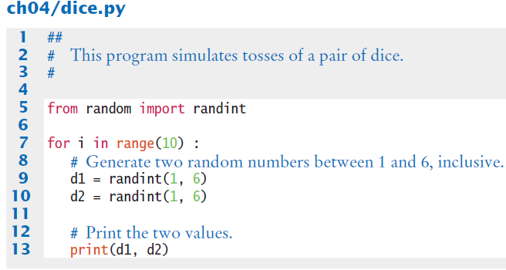
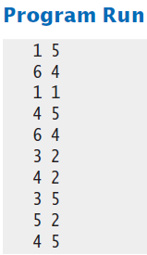
Simulating Die Tosses
Goal:
To generate a random integer in a given range we use the randint() function
Randint has two parameters, the range (inclusive) of numbers generated

Slide 4
Chapter Five: Functions

Slide 5
Chapter Goals
To be able to implement functions
To become familiar with the concept of parameter passing
To develop strategies for decomposing complex tasks into simpler ones
To be able to determine the scope of a variable
To learn how to think recursively
In this chapter, you will learn how to design and implement your own functions
Using the process of stepwise refinement, you will be able to break up complex tasks into sets of cooperating functions

Slide 6
Contents
Functions as Black Boxes
Implementing and Testing Functions
Parameter Passing
Return Values
Functions without Return Values
Reusable Functions
Stepwise Refinement
Variable Scope
Recursive Functions

Slide 7
Functions as Black Boxes
Section 5.1

Slide 8
Functions as Black Boxes
A function is a sequence of instructions with a name
For example, the round function, which was introduced in Chapter 2, contains instructions to round a floating-point value to a specified number of decimal places

Slide 9
Calling Functions
You call a function in order to execute its instructions
price = round(6.8275, 2) # Sets result to 6.83
By using the expression round(6.8275, 2), your program calls the round function, asking it to round 6.8275 to two decimal digits

Slide 10
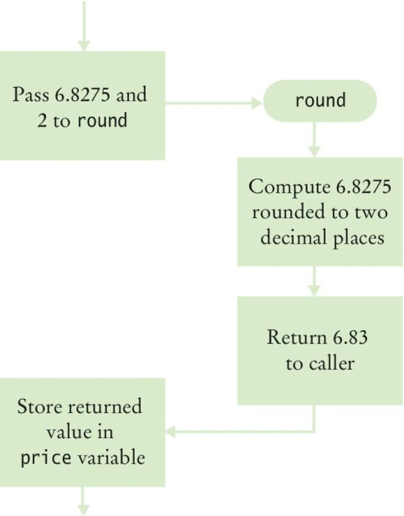
Calling Functions (2)
The round function returns its result back to where the function was called and your program resumes execution

Slide 11
Function Arguments
When another function calls the round function, it provides “inputs”, such as the values 6.8275 and 2 in the call round(6.8275, 2)
These values are called the arguments of the function call
Note that they are not necessarily inputs provided by a human user
They are the values for which we want the function to compute a result

Slide 12
Function Arguments
Functions can receive multiple arguments or it is also possible to have functions with no arguments

Slide 13
Function Return Values
The “output” that the round function computes is called the return value
Functions return only one value
The return value of a function is returned to the point in your program where the function was called
price = round(6.8275, 2)
When the round function returns its result, the return value is stored in the variable ‘price’ statement)

Slide 14
Function Return Values (2)
Do not confuse returning a value with producing program output which is produced when using a print() statement

Slide 15
Black Box Analogy
A thermostat is a ‘black box’
Set a desired temperature
Turns on heater/AC as required
You don’t have to know how it really works!
How does it know the current temp?
What signals/commands does it send to the heater or A/C?
Use functions like ‘black boxes’
Pass the function what it needs to do its job
Receive the answer

Slide 16
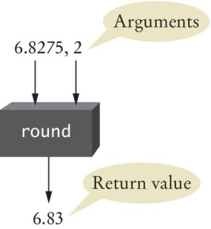
The round Function as a Black Box
You pass the round function its necessary arguments (6.8275 & 2) and it produces its result (6.83)

Slide 17
Designing Your Own Functions
When you design your own functions, you will want to make them appear as black boxes to other programmers
Even if you are the only person working on a program, making each function into a black box pays off: there are fewer details that you need to keep in mind

Slide 18
Implementing and Testing Functions
Section 5.2

Slide 19
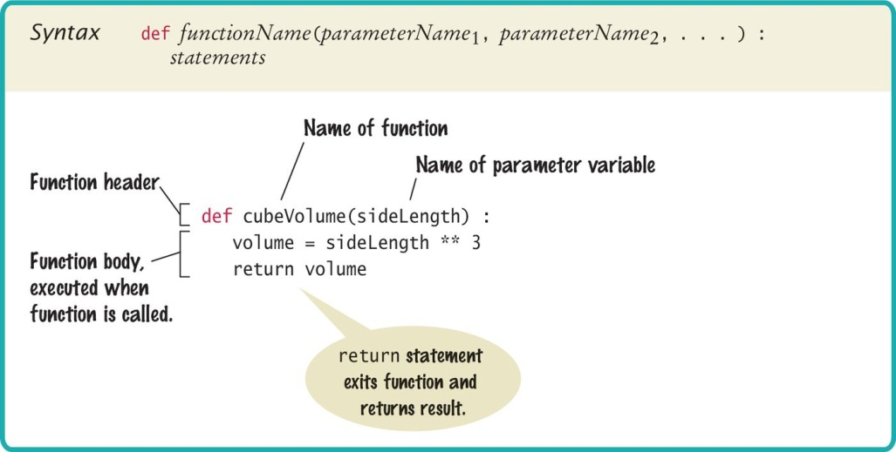
Syntax: Function Definition

Slide 20
Implementing and Testing Functions
A function to calculate the volume of a cube
What does it need to do its job?
What does it answer with?
When writing (‘defining’) this function
Pick a name for the function (cubeVolume)
Declare a variable for each incoming argument
(sideLength) (called parameter variables)
Put all this information together along with the def keyword to form the first line of the function’s definition:
This line is called the header of the function
def cubeVolume(sideLength):

Slide 21
Testing a Function
If you run a program containing just the function definition, then nothing happens
After all, nobody is calling the function
In order to test the function, your program should contain
The definition of the function
Statements that call the function and print the result

Slide 22
Calling/Testing the Cube Function
Implementing the function (function definition)
def cubeVolume(sideLength) :
volume = sideLength ** 3
return volume
Calling/testing the function
result1 = cubeVolume(2)
result2 = cubeVolume(10)
print("A cube with side length 2 has volume", result1)
print("A cube with side length 10 has volume", result2)

Slide 23
Syntax: Function Definition

Slide 24
Programming Tip: Function Comments
Whenever you write a function, you should comment its behavior
Remember, comments are for human readers, not compilers
## Computes the volume of a cube.
# @param sideLength the length of a side of the cube
# @return the volume of the cube
#
def cubeVolume(sideLength) :
volume = sideLength ** 3
return volume
Function comments explain the purpose of the function, the meaning of the parameter variables and the return value, as well as any special requirements

Slide 25
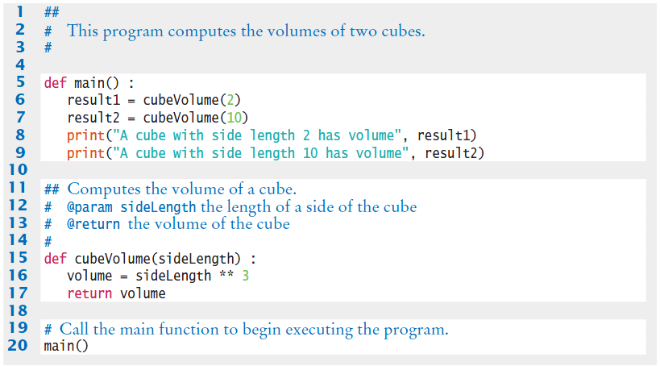

Cubes.py with Documentation

Slide 26
Demo Cubes.py

Slide 27
The main Function
When defining and using functions in Python, it is good programming practice to place all statements into functions, and to specify one function as the starting point
Any legal name can be used for the starting point, but we chose ‘main’ since it is the required function name used by other common languages
Of course, we must have one statement in the program that calls the main function

Slide 28
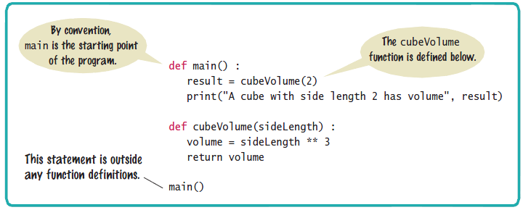
Syntax: The main Function

Slide 29
Using Functions: Order (1)
It is important that you define any function before you call it
For example, the following will produce a compile-time error:
print(cubeVolume(10))
def cubeVolume(sideLength) :
volume = sideLength ** 3
return volume
The compiler does not know that the cubeVolume function will be defined later in the program

Slide 30
Using Functions: Order (2)
However, a function can be called from within another function before the former has been defined
The following is perfectly legal:
def main() :
result = cubeVolume(2)
print("A cube with side length 2 has volume",
result)
def cubeVolume(sideLength) :
volume = sideLength ** 3
return volume
main()

Slide 31
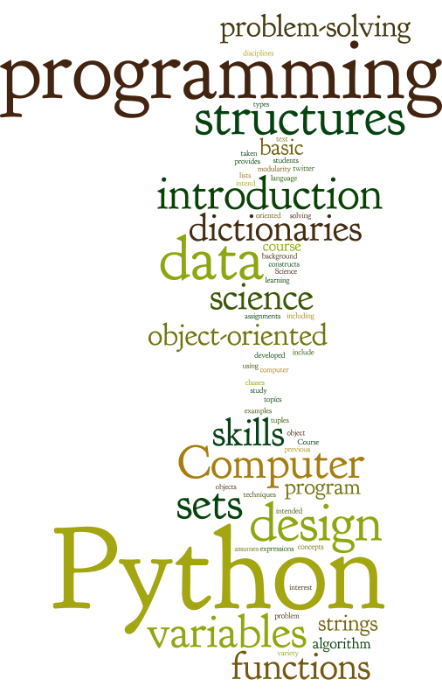

Slide 32
THURSDAY ☺

Slide 33
Parameter Passing
Section 5.3

Slide 34
Parameter Passing
Parameter variables receive the argument values supplied in the function call
The argument value may be:
The contents of a variable
A ‘literal’ value (2)
Aka, ‘actual parameter’ or argument
The parameter variable is:
Declared in the called function
Initialized with the value of the argument value
Used as a variable inside the called function
Aka, ‘formal parameter’
Calling function
Argument value
out
Parameter variable
in
Called function

Slide 35




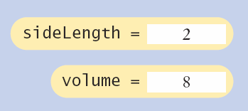
Parameter Passing Steps
result1 = cubeVolume(2)
def cubeVolume(sideLength):
volume = sideLength ** 3
return volume

Slide 36
Common Error 5.1
Trying to modify parameter variables
A copy of the argument values is passed (the Value is passed)
Called function (addTax) can modify local copy (price)
total = 10
addTax(total, 7.5);
copy
total
10.0
def addTax(price, rate):
tax = price * rate / 100
# No effect outside the function
price = price + tax
return tax;
price
10.75

Slide 37
Group Programming Activity
Create a function that prints your name to the screen x times. Where x is a value you request from the user by using input.
Create a function that adds two numbers together and prints the result. The two numbers are passed in as parameters to the function.
Create a function that determines whether a number is odd or even and prints “even” or “odd” to the screen. The number is passed in as a parameter
How do we call these functions

Slide 38
Return Values
Section 5.4

Slide 39
Return Values
Functions can (optionally) return one value
Add a return statement that returns a value
A return statement does two things:
Immediately terminates the function
Passes the return value back to the calling function
def cubeVolume (sideLength):
volume = sideLength ** 3
return volume
return statement
The return value may be a value, a variable or a calculation

Slide 40
Multiple return Statements (2)
Alternative to multiple returns (e.g., one for each branch):
You can avoid multiple returns by storing the function result in a variable that you return in the last statement of the function
For example:
def cubeVolume(sideLength) :
if sideLength >= 0:
volume = sideLength ** 3
else :
volume = 0
return volume

Slide 41
Make Sure A Return Catches All Cases
Missing return statement
Make sure all conditions are handled
In this case, sideLength could be equal to 0
No return statement for this condition
The compiler will not complain if any branch has no return statement
It may result in a run-time error because Python returns the special value None when you forget to return a value
def cubeVolume(sideLength) :
if sideLength >= 0 :
return sideLength ** 3
# Error—no return value if sideLength < 0

Slide 42
Make Sure A Return Catches All Cases (2)
A correct implementation:
def cubeVolume(sideLength) :
if sideLength >= 0
return sideLength ** 3
else :
return 0

Slide 43
Implementing a Function: Steps
Describe what the function should do
Provide a simple “liberal arts terms” description of what the functions does
“Compute the volume of a pyramid with a square base”
Determine a list of all of the functions inputs
Make a list of all of the parameters that can vary
Do not be overly specific
Determine the types of the parameter variables and the return value

Slide 44
Implementing a Function: Steps
Write pseudocode for obtaining the desired result
Express an mathematical formulas, branches and loops in pseudocode
Implement the function body
def pyramidVolume(height, baseLength) :
baseArea = baseLength * baseLength
return height * baseArea / 3

Slide 45
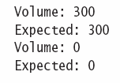
Implementing a Function: Steps
Test your function
Design test cases and code

Slide 46
Pyramids.py
Open the file pyramids.py
Look at how the main function is set up to make the calls to pyramidVolume and print the expected results

Slide 47
## # This program defines a function for calculating a pyramid's volume and # provides a unit test for the function. # def main() : print("Volume:", pyramidVolume(9, 10)) print("Expected: 300") print("Volume:", pyramidVolume(0, 10)) print("Expected: 0") ## Computes the volume of a pyramid whose base is a square. # @param height a float indicating the height of the pyramid # @param baseLength a float indicating the length of one side of the pyramid's base # @return the volume of the pyramid as a float # def pyramidVolume(height, baseLength) : baseArea = baseLength * baseLength return height * baseArea / 3 # Start the program. main()

Slide 48
Functions Without Return Values
Section 5.5

Slide 49

Functions Without Return Values
functions are not required to return a value
No return statement is required
The function can generate output even when it doesn’t have a return value
...
boxString("Hello")
...
def boxString(contents) :
n = len(contents) :
print("-" * (n + 2))
print("!" + contents + "!")
print("-" * (n + 2))

Slide 50
Using return Without a Value
You can use the return statement without a value
The function will terminate immediately!
def boxString(contents) :
n = len(contents)
if n == 0 :
return # Return immediately
print("-" * (n + 2))
print("!" + contents + "!")
print("-" * (n + 2))

Slide 51
Exam Prep
Consider the following program:
def main() :
a = 2
doubleIt(a)
print(a)
def doubleIt(x) :
return x * 2
main()
What output is generated when this program is run?
2
4
8
Nothing, Python reports an error

Slide 52
Zybook Demos

Slide 53
Group Activity
Create a function that calculates and returns the average of three values that are passed in as variables. def myAverage(a, b, c) :
Create a function that adds all the odd numbers between two values (inclusive) together and returns the sum and also prints the range (the difference between the two values) to the screen.
def mySumOdd (low, hi):

Slide 54
0
0
5
4
3
2
1
0
0
9
8
7
6
5
4
3
2
1
0
9
8
7
6
5
4
3
2
1
0
9
8
7
6
5
4
3
2
1
0
9
8
7
6
5
4
3
2
1
0
9
8
7
6
5
4
3
2
1
0
9
8
7
6
5
4
3
2
1
0
0
5
0
4
Hours
Minutes
Seconds

Slide 55
0
0
5
4
3
2
1
0
0
9
8
7
6
5
4
3
2
1
0
9
8
7
6
5
4
3
2
1
0
9
8
7
6
5
4
3
2
1
0
9
8
7
6
5
4
3
2
1
0
9
8
7
6
5
4
3
2
1
0
9
8
7
6
5
4
3
2
1
0
0
4
0
3
Hours
Minutes
Seconds

Slide 56
0
0
5
4
3
2
1
0
0
9
8
7
6
5
4
3
2
1
0
9
8
7
6
5
4
3
2
1
0
9
8
7
6
5
4
3
2
1
0
9
8
7
6
5
4
3
2
1
0
9
8
7
6
5
4
3
2
1
0
9
8
7
6
5
4
3
2
1
0
0
3
0
2
Hours
Minutes
Seconds

Slide 57
0
0
5
4
3
2
1
0
0
9
8
7
6
5
4
3
2
1
0
9
8
7
6
5
4
3
2
1
0
9
8
7
6
5
4
3
2
1
0
9
8
7
6
5
4
3
2
1
0
9
8
7
6
5
4
3
2
1
0
9
8
7
6
5
4
3
2
1
0
0
2
0
1
Hours
Minutes
Seconds

Slide 58
0
0
5
4
3
2
1
0
0
9
8
7
6
5
4
3
2
1
0
9
8
7
6
5
4
3
2
1
0
9
8
7
6
5
4
3
2
1
0
9
8
7
6
5
4
3
2
1
0
9
8
7
6
5
4
3
2
1
0
9
8
7
6
5
4
3
2
1
0
0
1
0
0
Hours
Minutes
Seconds

Slide 59
Reasons for defining functions
Improve program readability – A program can be easier to read and understand if it calls high level functions, rather than being cluttered with computation details.
Encourages modular program development – A function has well-defined input and output. As such, a programmer can focus on developing a particular function of the program independently of other functions.
Reduces redundant code – Functions may be called from multiple places in a program. A function can be defined once then called from those multiple places, thus avoiding redundant code

Slide 60
Reusable Functions
Section 5.6

Slide 61
Problem Solving: Reusable Functions
Find repetitive code
May have different values but same logic
hours = int(input("Enter a value between 0 and 23: "))
while hours < 0 or hours > 23 :
print("Error: value out of range.")
hours = int(input("Enter a value between 0 and 23: "))
minutes = int(input("Enter a value between 0 and 59: "))
while minutes < 0 or minutes > 59 :
print("Error: value out of range.")
minutes = int(input("Enter a value between 0 and 59: "))
0 - 23
0 - 59

Slide 62
Write a ‘Parameterized’ Function
## Prompts a user to enter a value up to a given maximum until the user provides
# a valid input.
# @param high an integer indicating the largest allowable input
# @return the integer value provided by the user (between 0 and high, inclusive)
#
def readIntUpTo(high) :
value = int(input("Enter a value between 0 and " + str(high) + ": "))
while value < 0 or value > high :
print("Error: value out of range.")
value = int(input("Enter a value between 0 and " + str(high) + ": "))
return value

Slide 63
Stepwise Refinement
Section 5.7

Slide 64
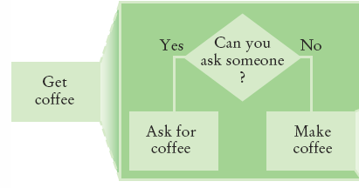
Stepwise Refinement
To solve a difficult task, break it down into simpler tasks
Then keep breaking down the simpler tasks into even simpler ones, until you are left with tasks that you know how to solve

Slide 65
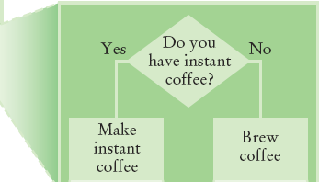
Get Coffee
If you must make coffee, there are two ways:
Make Instant Coffee
Brew Coffee

Slide 66
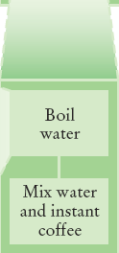
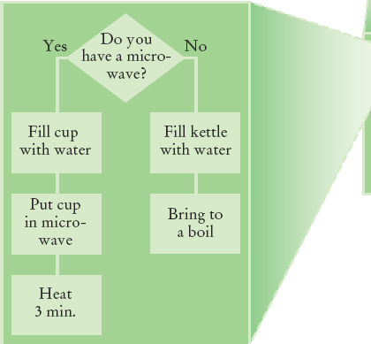
Instant Coffee
Two ways to boil water
1) Use Microwave
2) Use Kettle on Stove

Slide 67
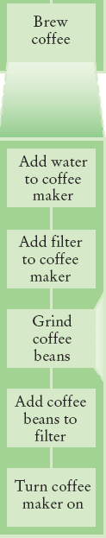
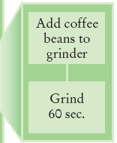
Brew Coffee
Assumes coffee maker
Add water
Add filter
Grind Coffee
Add beans to grinder
Grind 60 seconds
Fill filter with ground coffee
Turn coffee maker on
Steps are easily done

Slide 68
Stepwise Refinement: Textual Analysis
In 1949, Dr. Flesch proposed a measure of text readability known as the Flesch Index. The index is based on the average number of syllables per word and the average number of words per sentence in a piece of text. Index scores usually range from 0 to 100, and indicate readable prose for the following grade levels:
Develop a program that computes the Flesch Index as well as the Grade level for a text stored in a string
Flesch Index | Grade Level of Readability
0 – 30 | College
50 – 60 | High School
90 – 100 | Fourth Grade

Slide 69

The Flesch Index is
$F=206.835 −1.015 ∗\left(\frac{words}{sentences}\right)−84.6 ∗\left(\frac{syllables}{words}\right)$
The Flesch-Kincaid Grade level Formula is
$G=0.39 ∗\left(\frac{words}{sentences}\right)+11.8 ∗\left(\frac{syllables}{words}\right)−15.59$
Word | Any sequence of non-whitespace characters
Sentence | Any sequence of words ending in a period, question mark, exclamation point, colon, or semicolon
Syllable | Any word of three characters or less; or any vowel (a,e,i,o,u) or pair of consecutive vowels, except for a final –es, -ed, or –e that is not -le

Slide 70
What does the program need to do
INPUT: Get the string of text
Count the sentences in the text
Count the words in the text
Count the syllables in the text
Compute the Flesch Index
Compute the Grade Level
OUTPUT: Print the Flesch Index and Grade level as well as the number of sentences, words and syllables in the text

Slide 71
Name the Sub-Tasks
Get Input
Count Sentences
Count words
Count syllables
Compute FleschIndex
Computer GradeLevel
Output

Slide 72
Write Pseudocode
Get Input
Text = get std. input
Count Sentences
Search and count all the ending characters in the code
Count words
Split the text each time you see a “ ”
Count syllables
Count the number of times you see vowels in the text
If you have a word that ends in es, ed or e subtract 1
If you have a word that ends in le add 1 to the total count
Compute FleschIndex
Math
Computer GradeLevel
Math
Output
Print

Slide 73
Variable Scope
Section 5.8

Slide 74
Variable Scope
Variables can be declared:
Inside a function
Known as ‘local variables’
Only available inside this function
Parameter variables are like local variables
Outside of a function
Sometimes called ‘global scope’
Can be used (and changed) by code in any function
How do you choose?
The scope of a variable is the part of the program in which it is visible

Slide 75
Examples of Scope
sum, square & i are local variables in main
def main() :
sum = 0
for i in range(11) :
square = i * i
sum = sum + square
print(square, sum)
sum
i
square

Slide 76
Local Variables of functions
Variables declared inside one function are not visible to other functions
sideLength is local to main
Using it outside main will cause a compiler error
def main():
sideLength = 10
result = cubeVolume()
print(result)
def cubeVolume():
return sideLength * sideLength * sideLength # ERROR

Slide 77
Re-using Names for Local Variables
Variables declared inside one function are not visible to other functions
result is local to square and result is local to main
They are two different variables and do not overlap
This can be very confusing
def square(n):
result = n * n
return result
def main():
result = square(3) + square(4)
print(result)
result
result

Slide 78
Global Variables
They are variables that are defined outside functions
A global variable is visible to all functions that are defined after it
However, any function that wishes to use a global variable must include a global declaration

Slide 79
Global Variable Usage
Assignment of global variables in functions should be used sparingly. If a local variable (including a parameter) has the same name as a global variable, than the name refers to the local item (so the global item is inaccessible inside such a function). Such naming can be very confusing to a reader.
Furthermore, if a function updates the global variable, then that function's behavior is no longer limited to its parameters and return value; the function may have side effects that are hard for a programmer to recognize. As such, use of global variables is typically limited to defining constants that are independent of any function, such as the number of centimeters per inch above.
Good practice is to minimize the use of non-constant global variables. Non-constant global variables should generally be avoided (with a few exceptions), especially by beginner programmers.

Slide 80
Programming Tip
There are a few cases where global variables are required (such as pi defined in the math module), but they are quite rare
Programs with global variables are difficult to maintain and extend because you can no longer view each function as a “black box” that simply receives arguments and returns a result
Instead of using global variables, use function parameter variables and return values to transfer information from one part of a program to another

Slide 81
Example Use of a Global Variable
If you omit the global declaration, then the balance variable inside the withdraw function is considered a local variable
balance = 10000 # A global variable
def withdraw(amount) :
# This function intends to access the
# global ‘balance’ variable
global balance
if balance >= amount :
balance = balance - amount

Slide 82
Demo

Slide 83
Activity
Which lines are in the scope of the variable i used in line 10?
Lines 10 - 13
Which lines are in the scope of the parameter variable x defined on line 8
Lines 8 - 13
The program defines two local variables with the same name whose scopes don’t overlap. What are they?
The variables x
Which line defines a global variable?
Line 1
There is a scope error in the main function. What is it, and how do you fix it
s is being accessed in main
1 y = 8
2 3 def main(): 4 x = 4 5 x = mystery(x+1) 6 print(s) 7 8 def mystery(x): 9 s = 0 10 for i in range(x): 11 x = i + 1 12 s = s + x 13 return s

Slide 84
Programming Tips
Keep functions short
If more than one screen, break into ‘sub’ functions
Trace your functions
One line for each step
Columns for key variables
Use Stubs as you write larger programs
Unfinished functions that return a ‘dummy’ value

Slide 85
Group Activity
Create a Valentine’s day Suggestor.
This program should first get user input to determine the gender of the gift recipient. Next, it should get how much the individual plans to spend on the gift. Based on the input it should tell the giver what is the best store they should go to in order to get a good gift for that price.
For each gender, has at least 3 options.
You must create and use at least two functions namely
femaleStoreSuggestor(amt) maleStoreSuggestor(amt)

Slide 86
Summary

Slide 87
Summary: Functions
A function is a named sequence of instructions
Arguments are supplied when a function is called
The return value is the result that the function computes
When declaring a function, you provide a name for the function and a variable for each argument
Function comments explain the purpose of the function, the meaning of the parameters and return value, as well as any special requirements
Parameter variables hold the arguments supplied in the function call

Slide 88
Summary: Function Returns
The return statement terminates a function call and yields the function result
Complete computations that can be reused into functions
Use the process of stepwise refinement to decompose complex tasks into simpler ones
When you discover that you need a function, write a description of the parameter variables and return values
A function may require simpler functions to carry out its work

Slide 89
Summary: Scope
The scope of a variable is the part of the program in which the variable is visible
Two local or parameter variables can have the same name, provided that their scopes do not overlap
You can use the same variable name within different functions since their scope does not overlap
Local variables declared inside one function are not visible to code inside other functions

